Slide 1

Software Engineering
Introduction to Software Engineering
Department of Computer Science and Engineering
Acknowledgement: Authors of the prescribed textbooks and materials sourced online.

Slide 2

Software Engineering
Agile Philosophy
Department of Computer Science and Engineering

Slide 3
Limitations of most Legacy Models
Can you think of some limitations of legacy models?
Predictive software development methods
Upfront planning
Do not facilitate periodic customer interaction
Suited for very large complex projects
Regulatory perspectives
Suited for global or distributed organizations
Product lifecycle and its ecosystem
People and skill perspective
Suitable for projects with clear definition
Suitable when things are not changing fast

Slide 4
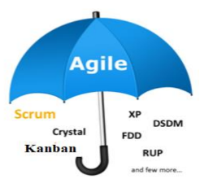
Agile Philosophy
Agile is an umbrella term used to describe a variety of methods.
These methods encourage
Continual realignment of development goals with needs and expectations of the customer
Reducing massive planning overhead to allow fast reactions to change
Agile is not a process. It is a set of values or a philosophy.
AGILE
Rapid
Adaptable
Iterative
Quality driven
Cooperative

Slide 5

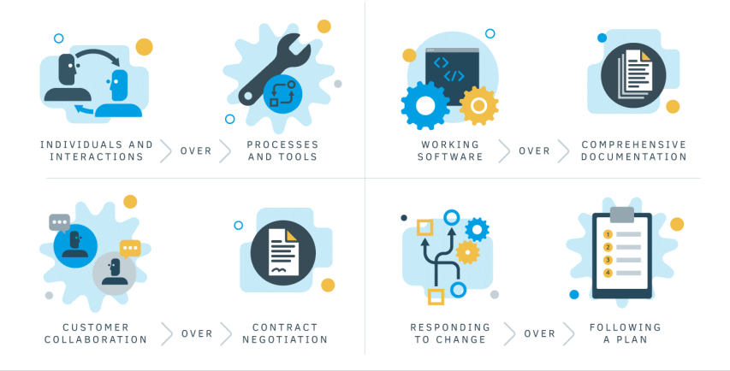
Agile Manifesto
Individuals and interactions are valued more than Processes and tools
Working software is valued more than Comprehensive documentation
Customer collaboration is valued more than Contract negotiation
Responding to change is valued more than Following a plan
Focus on Simplicity in both the product and the process

Slide 6
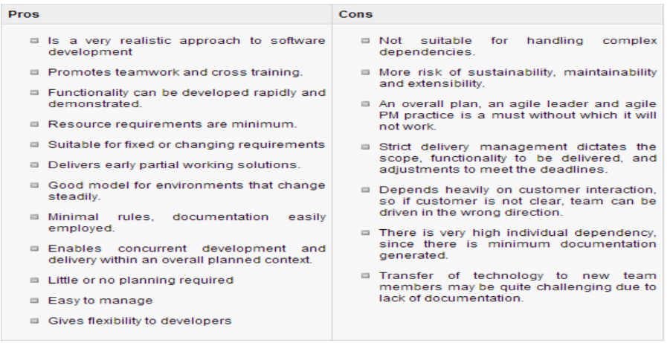
Pros & Cons of Agile Methodology

Slide 7
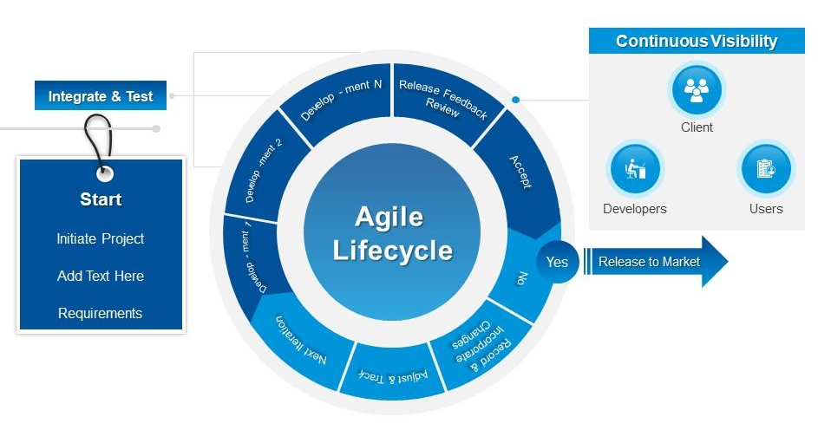
What if SDLC is made Agile?

Slide 8

Agile methodologies: Scrum
Origin – Rugby
In rugby, everyone has a part and they huddle periodically to take stock
What is Scrum?
Methodology/framework for developing, delivering and sustaining software components and products
Iterative approach towards software development
Provides mechanisms to apply agile practices
Scrum is defined by
Roles
Rules
Events
Artifacts

Slide 9
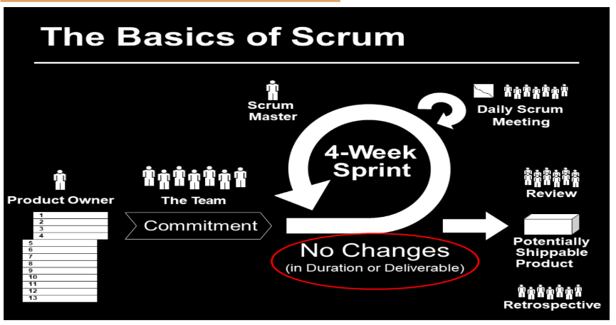
Agile methodologies – Scrum Basics

Slide 10
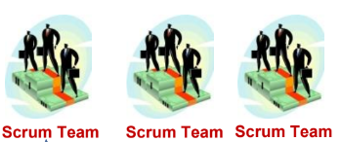


Agile methodologies – Scrum Roles
Organization is split into small, cross functional and self organizing teams.
SCRUM TEAMS
Cross functional and self organizing
Consists of contributors to deliverable
Responsible for delivering shippable increments
SCRUM MASTER
PROJECT OWNER
Is a facilitator (Not a manager!)
Removes impediments & facilitates meetings
Ensures team sticks to scrum theory and practices
Voice of stakeholder/team
Creates or manages product backlog

Slide 11
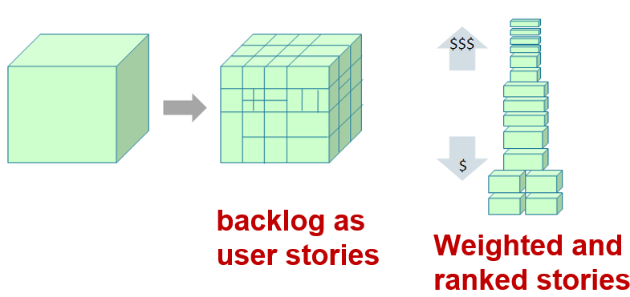
Agile methodologies – Scrum Artifacts
What is Product Backlog?
The project/product is described as a list of features called Product Backlog.
What does Product Backlog include?
New features
Changes to existing features
Bug fixes
Infrastructure setups etc.
Product Backlog
Features are described in terms of user stories
The features/stories in the backlog planned for a sprint is the sprint backlog
The stories are ranked by importance by estimating the amount of work needed to be done by Scrum team
Results in Roadmap

Slide 12
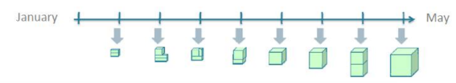
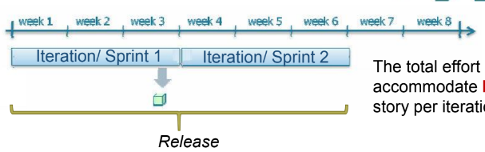
Agile methodologies – Scrum Events
SPRINT
Short fixed iterations (usually 2 – 4 weeks)
Potentially shippable code demonstrated after each iteration
(time boxing)
SPRINT PLANNING MEETING
Used to determine which of the product backlog items will be worked on & delivered in the next iteration
The total effort each iteration can accommodate leads to number of user story per iteration
One release may contain multiple iterations

Slide 13
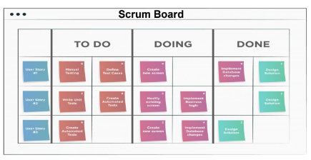
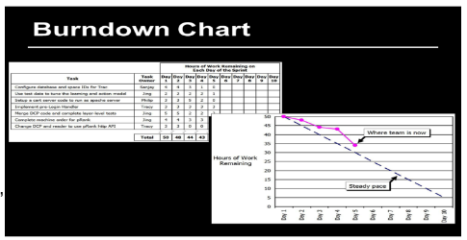
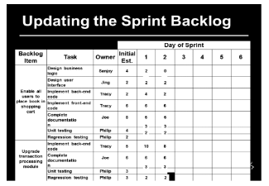
Agile methodologies – Scrum Events
Daily scrum meeting (also called stand up meeting). Things discussed in these meetings:
• What did you do yesterday?
• What will you do today?
• Any obstacles?
Updating the sprint backlog on Scrum board/Burndown chart
End of sprint deliverable – Shippable product

Slide 14

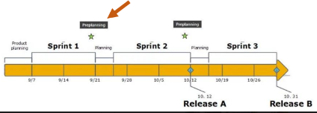
Agile methodologies – Sprint Pre Planning
What is Pre Planning meeting?
A Pre-Planning meeting enables the business and stakeholders to focus on prioritization
and preparation of requirements far advance before the sprint planning session.
Why is Pre Planning meeting necessary?
Every sprint will need to have one prioritized list of requirements (set by business represented by the product owner) so there can be a focus on, and deliver the most valuable and needed requirements in a very short time
It is quite challenging to prepare the backlog for any upcoming sprint
Product Owner needs to talk and align requirements of multiple stakeholders which is not easy as every stakeholder has their own priorities that influence the plans of other stakeholders
There can be one or a couple of more of these Pre Planning sessions.
What are the outcomes of the Pre Planning meeting?
• Scope for the next sprint agreed.
• The readiness of requirements is indicated to the product owner
• Rough estimation in story-points.

Slide 15
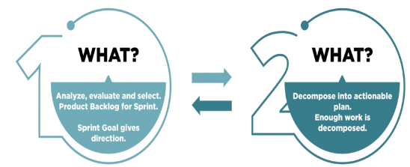
Agile methodologies – Sprint Planning
What is Sprint Planning?
Event that kick starts the Sprint
Agenda – define the scope of delivery and how to accomplish that work
Sets a common goal for the team during the sprint
Who attends the Sprint Planning?
Development Team
Product Owner
Facilitate the Sprint planning meeting
Ensures agreement on the Sprint goal and product backlog items
Scrum Master
Prioritize the backlog items
Propose the Sprint goal
Determine how many backlog items can be completed
How they will do it
Inputs to Sprint Planning
Activities of Sprint Planning
Product backlog
Identify Sprint goal
Sprint team capacity
Choose user stories
Past performance of Dev team
Plan for capacity

Slide 16
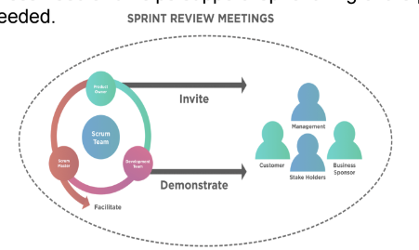
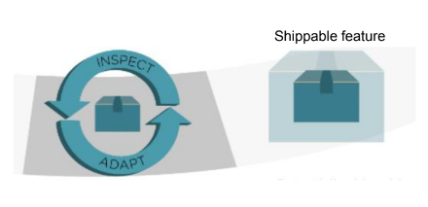
Agile methodologies – Sprint Review
What is Sprint Review meeting?
It is used to demonstrate story features
What is done during Sprint Review meeting?
Product owner does the following:
Evaluates against preset criteria
Gets feedback from clients and stakeholders
Ensures the delivered increment meets the business need
Helps support re-prioritizing of the product backlog
Optimize the release plan if needed
What is Sprint Retrospective?
It is the final team meeting in the Sprint to determine what went well, what didn't go well, and how the team can improve in the next Sprint. Attended by the team and the Scrum Master.
It is used for optimizing the process after every iteration.

Slide 17
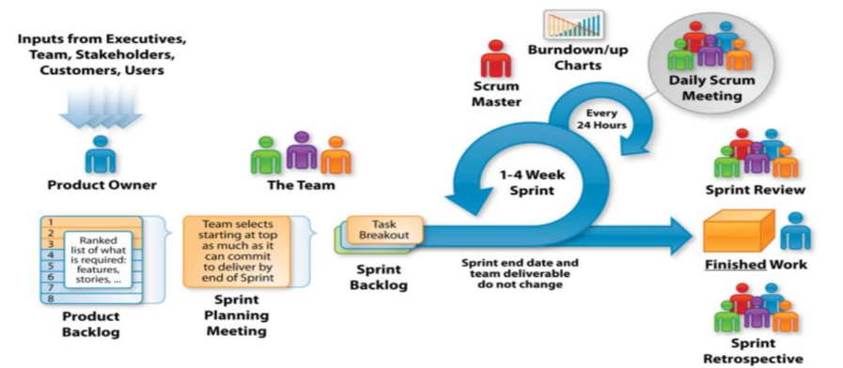
Agile methodologies – Scrum Summary
So instead of a large group spending a long time building a big thing, we have a small team spending a short time building a small thing but integrating regularly to see the whole

Slide 18

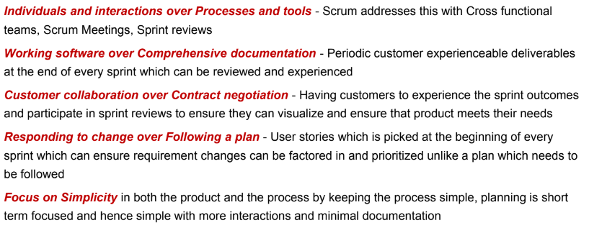
Agile methodologies – Scrum In-Class Exercise
How is Scrum aligned to the Agile Manifesto?

Slide 19
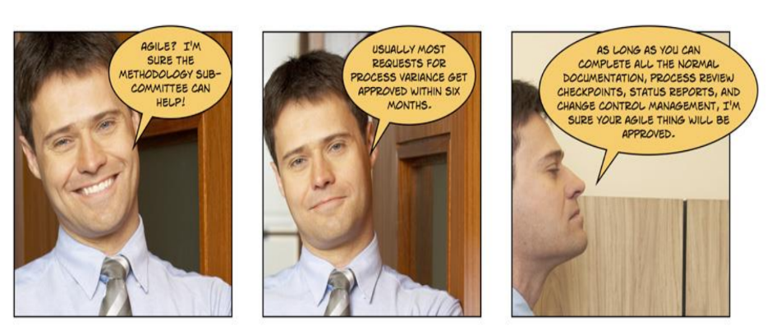
Agile methodologies – Wordplay!

Slide 20
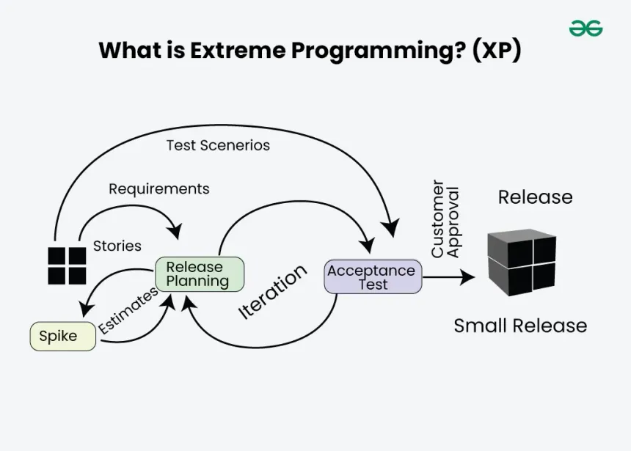
Agile methodologies – Extreme Agile Programming (XP)
What is XP?
The development team estimates, plans, and delivers the highest priority user stories in the form of working, tested software on an iteration by iteration basis
Delivery of working software at very frequent intervals, typically every 1-2 weeks
Continuous feedback and test-driven development
How is XP different when compared to Scrum?
SCRUM | XP
Framework for management of project | Specifies engineering practices like pair programming, test driven development
Requirement change granularity is once | Requirement change granularity is anytime
Features not developed in strict order | Features developed in strict order
Usage: Requirements are unsure
System is not too big
Customer is onsite

Slide 21
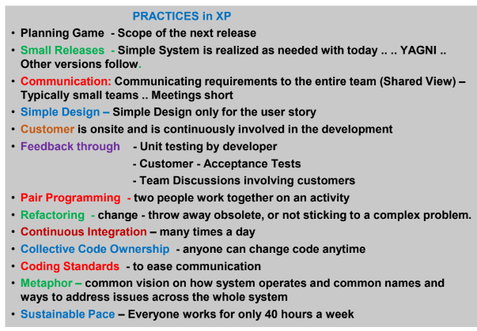
Agile methodologies – Extreme Agile Programming (XP)

Slide 22
Agile methodologies – Lean Agile
Agile and Lean are two popular approaches that help teams deliver faster, more sustainable results and thus value to customers
AGILE
Aim for iterative development that delivers early prototype of a new product or service or a subset of features out into customers' hands as quickly as possible
Small batches
Iterative and continuous course correction and delivering of components
Focused on course corrections during development
Focus is to develop a product which addresses the customer needs and expectations
LEAN
Seek to identify and eliminate activity that is not valued by the customer or end user
Eliminating waste
Continuous inspection to adapt and improve. (typically called Kaizen)
Looks to boost performance
Focus is to provide a product which addresses the customer needs and expectations in the most efficient fashion

Slide 23
Agile methodologies – Lean Agile Practices/Principles
Eliminate waste
Amplify learning using active feedback
Decide as late as possible
Deliver as fast as possible
Empower the team to follow a controlled low overhead plan
Build integrity in as processes
Consider the whole system

Slide 24
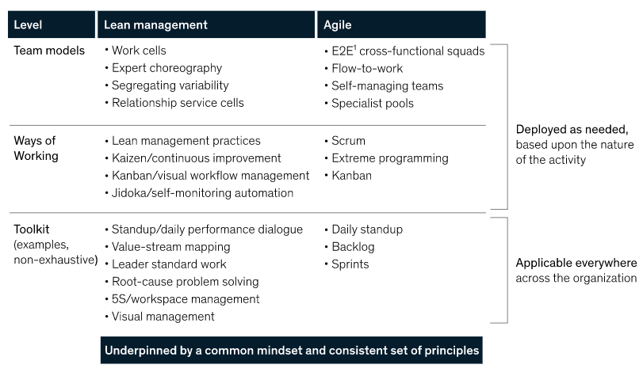
Agile methodologies – Lean Agile
logical and strategic arrangement of resources in a business environment including people
https://www.mckinsey.com/business-functions/operations/our-insights/lean-management-or-agile-the-right-answer-may-be-both

Slide 25
THANK YOU

